Slide 1
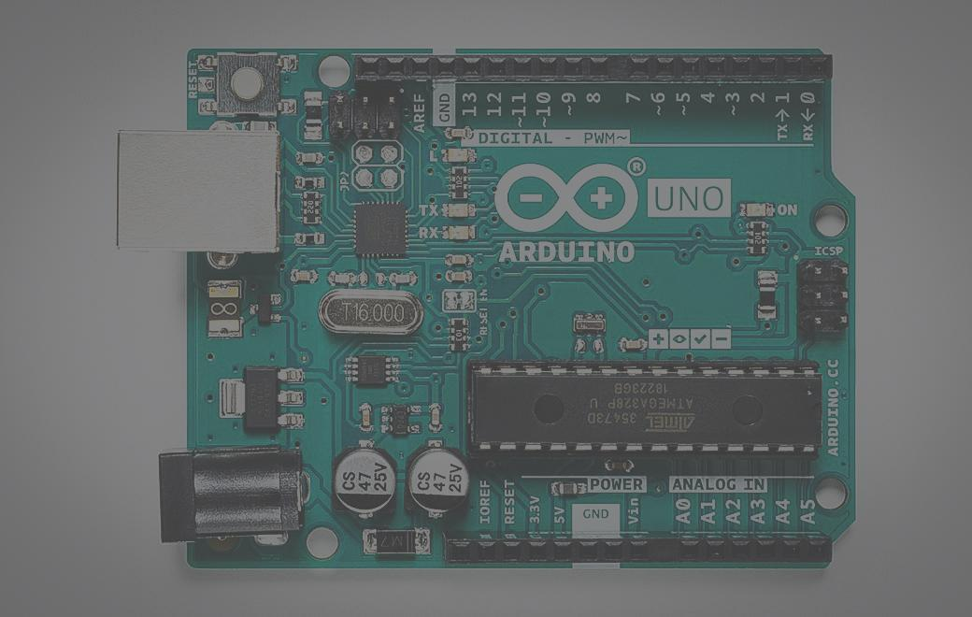
AUTOMATIC WATERING SYSTEM FOR PLANTS
GROUP-13
TEAM MEMBERS:
Rushil Venkateswar-20CS30045
Pentamsetty Tharakeswar-20CS10044
Karamcheti Vamsy-20CS30025
VenkataSnehithReddy-20EC10028
Khethavath Tejaswini-20MT30012

Slide 2
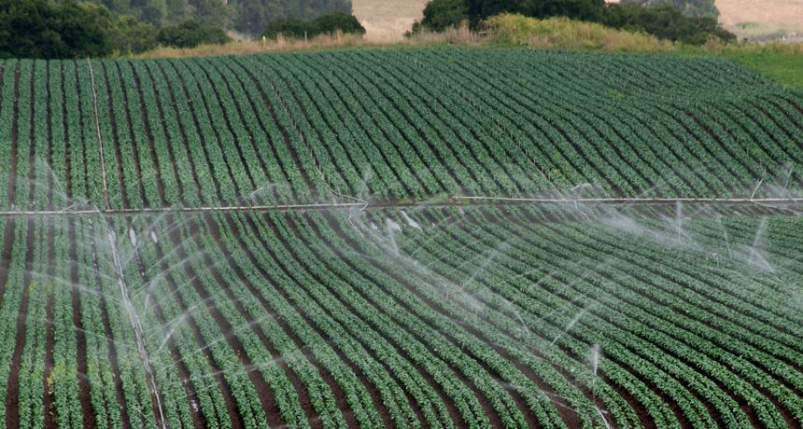
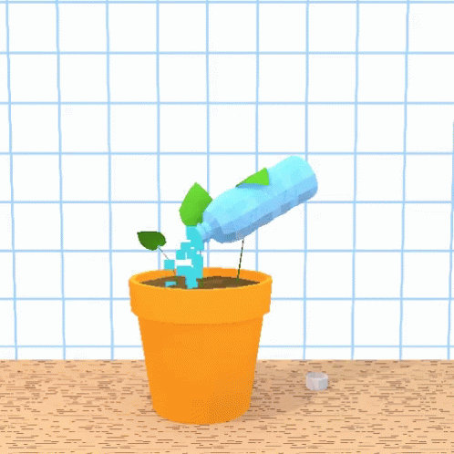
An ‘automatic watering system’ is a soil moisture sensor based water supply for crops which minimizes human intervention to just supervision. All water delivery systems like drip, surface, or sprinklers can be automated. There are various benefits for automation where the major one is reducing labor cost in exchange for an efficient water supply system. Usually the automation is installed by an engineer after assessing the field length, weather, micro-climate, humidity, soil properties and water requirement by the crops for efficient watering of plants.
WHY AUTOMATIC WATERING SYSTEM?
Notes:
An ‘automatic watering system’ is a computer/timer-based water supply for crops which minimizes human intervention to just supervision. All water delivery systems like drip, surface, or sprinklers can be automated. There are various benefits for automation where the major one is reducing labor cost in exchange for an efficient water supply system. Usually the automation is installed by an engineer after assessing the field length, weather, micro-climate, humidity, soil properties and water requirement by the crops for efficient watering of plants.
The automatic watering systems undoubtedly is helping the farmers conserve water, thereby improving society. In any irrigation system, the prime motive will be to use the water most efficiently and that’s precisely what has been done here by automatic watering systems.

Slide 3

Watering systems can be effectively used to water plants when they need it. But this manual process of watering requires two essential aspects: when and how much water to be added to replace manual activities and make the Gardeners work more comfortable. To rectify this, we have created this model.
FOR HOME GARDENING:
Notes:
An ‘automatic watering system’ is a computer/timer-based water supply for crops which minimizes human intervention to just supervision. All water delivery systems like drip, surface, or sprinklers can be automated. There are various benefits for automation where the major one is reducing labor cost in exchange for an efficient water supply system. Usually the automation is installed by an engineer after assessing the field length, weather, micro-climate, humidity, soil properties and water requirement by the crops for efficient watering of plants.
The automatic watering systems undoubtedly is helping the farmers conserve water, thereby improving society. In any irrigation system, the prime motive will be to use the water most efficiently and that’s precisely what has been done here by automatic watering systems.

Slide 4
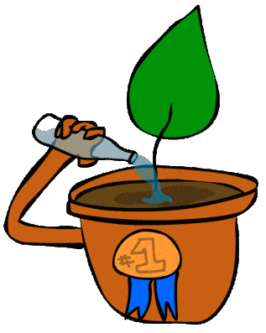
OUR APPROACH
Hearin we introduce automatic plant watering system which is the most beneficial automated system, which helps people in their daily activities by reducing or completely replacing their effort .this system uses sensor Technology along with microcontroller and other electronics in order to behave like Smart switching system which senses soil moisture level and irrigates the plant.
The purpose of this work is to show how someone can easily make their own and cheap automatic plant watering system in just a few hours by connecting specific electronic components and other materials required .
Notes:
Hear in we introduce automatic plant watering system which is the most beneficial automated activities by reducing or completely represent their effort .this system uses sensor Technology along with microcontroller and other electronics in order to behave like Smart Kitchen system with sensors soil moisture level and irrigated the plant is necessary

Slide 5

WORKING PRINCIPLE
Automatic Plant Watering System Using Arduino UNO. In this system, soil moisture sensor senses the moisture level of the soil. If soil will get dry then sensor senses low moisture level and automatically switches on the water pump to supply water to the plant.
Notes:
Hear in we introduce automatic plant watering system which is the most beneficial automated activities by reducing or completely represent their effort .this system uses sensor Technology along with microcontroller and other electronics in order to behave like Smart Kitchen system with sensors soil moisture level and irrigated the plant is necessary

Slide 6
COMPONENTS
USED
Arduino Uno
USB Programming Cable
Relay (HW 307)
Breadboard
Jumper Cables
Ultrasonic Sensor (HC-SR04)
Temp & Humidity Sensor(DHT11)
Soil moisture Sensor
9V Battery
Mini Water Pump

Slide 7

WORKING PRINCIPLE OF
INDIVIDUAL PARTS

Slide 8
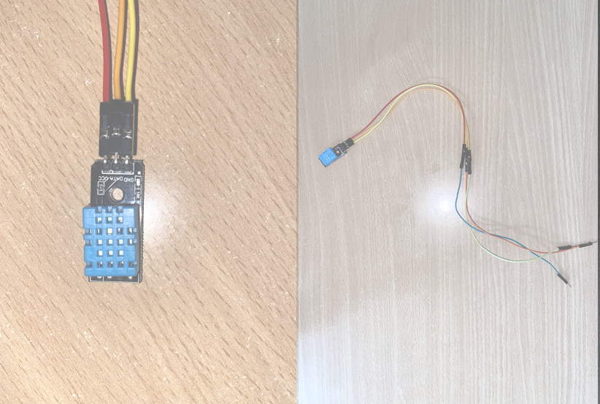
DHT 11
SENSOR
DHT11 sensor measures both the temperature and humidity of the zone of the plant. The analogue pins of an Arduino board such that it converts to the digital output and displays both values using the LCD.

Slide 9
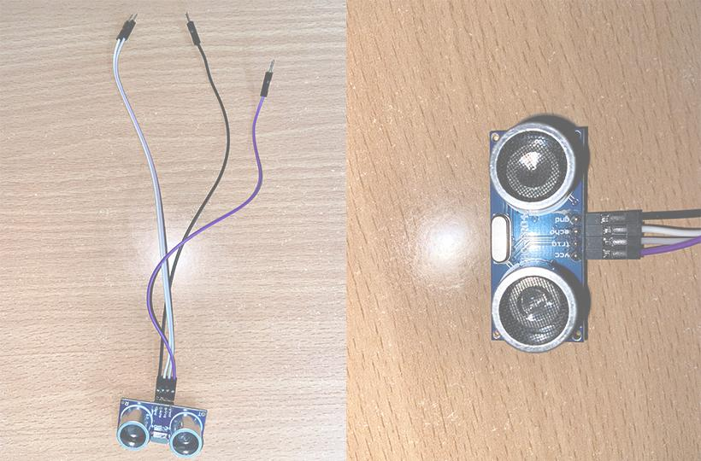
ULTRASONIC SENSOR
HC-SR04
THE HC-SR04 ULTRASONIC MODULE IS A MODULE THAT CAN PROVIDE NON-CONTACT MEASUREMENT WITHIN THE RANGE OF 2 CM TO 400 CM WITH RANGING ACCURACY THAT CAN REACH 3MM IT WORKS ON THE PRINCIPLE OF ECHOLOCATION.

Slide 10
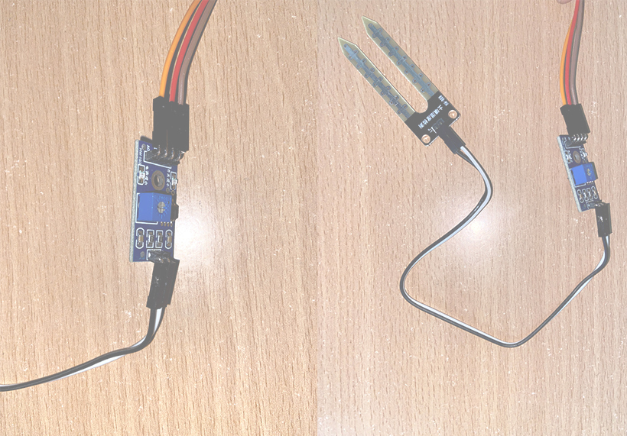
SOIL MOISTURE
SENSOR
IT IS USED TO MEASURE THE VOLUMETRIC WATER CONTENT OF SOIL.

Slide 11
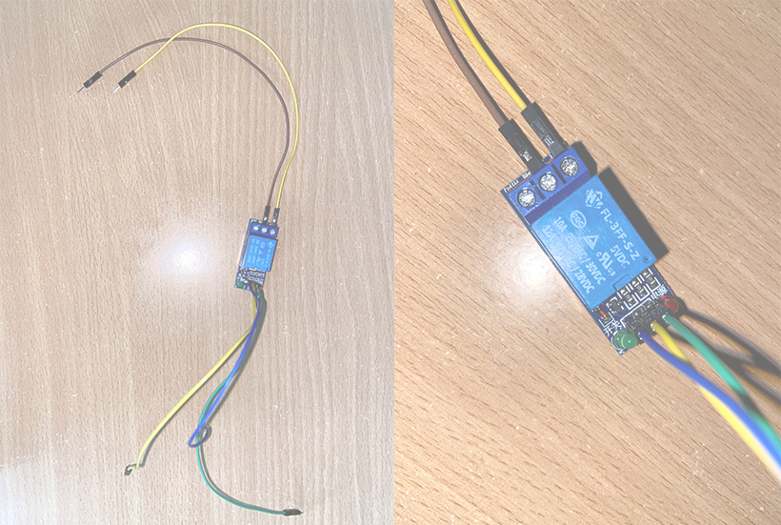
RELAY MODULE
Relay device uses a low power signal to control another high powered circuit while they are entirely separate. It is an Electromagnetic device that is used to connect two circuits magnetically and isolate them electrically.

Slide 12
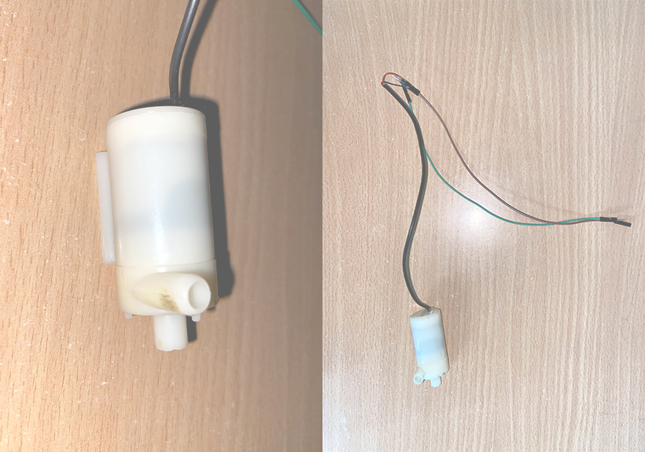
5V DC PUMP
A Pumping mechanism is used to deliver the needed amount of water to the soil.

Slide 13
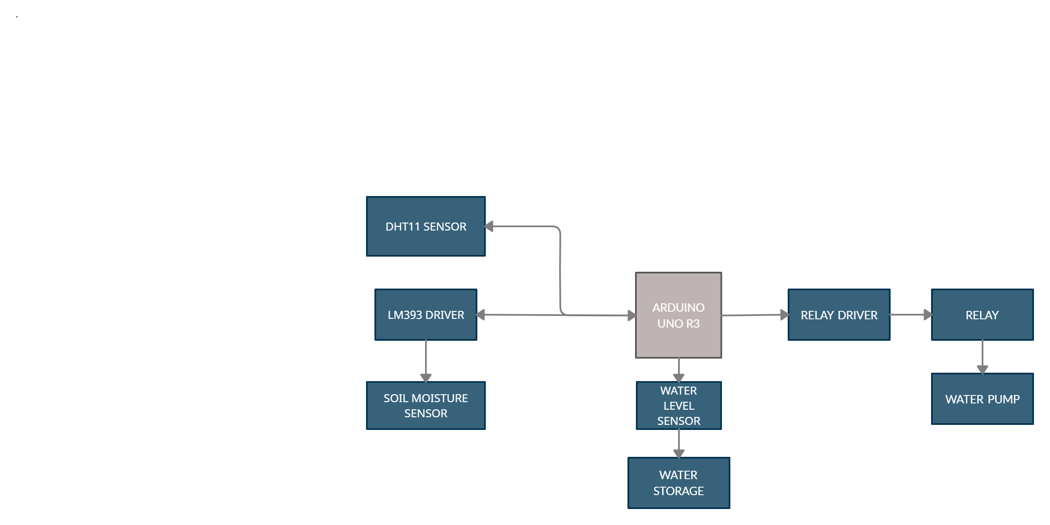
FLOW CHART OF THE CONNECTIONS

Slide 14
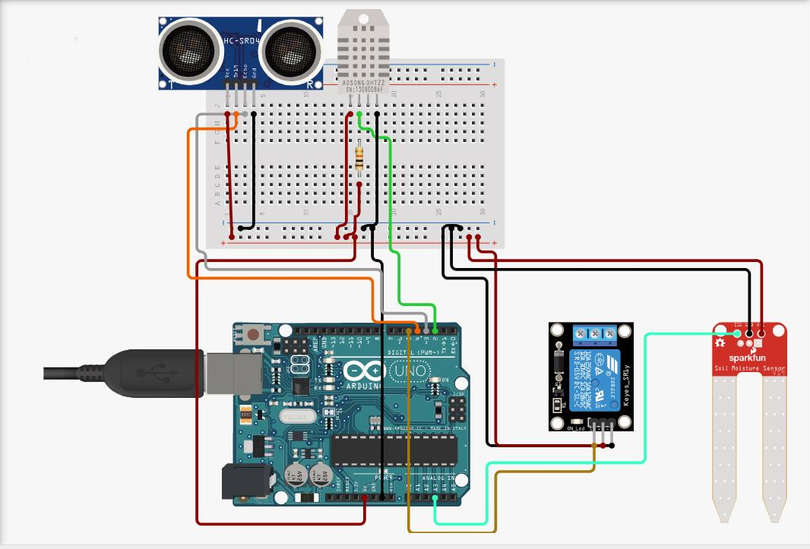
ARDUINO-UNO PIN DIAGRAM

Slide 15
WORKING
The program first checks the level of water in the bucket. If it lies close to 30, the depth gauge would turn red in the node red server.
After this, the moisture sensor is activated which gives a reading of ~300 for wet soil and ~1000 for dry soil and because of this fact, the threshold value is set to 600. When the readings goes above 600 (i.e. dry conditions) the relay pin is switched on for 2 sec and then switched off for 4 sec to let the water soak in the soil.
Lastly we check the DHT11 sensor for humidity and temperature values, and compute the heat index using the library function of dht.
All the sensor values are displayed in one line, separated by commas with no spaces so that node-red can read the output from serial and display it appropriately using bar graphs and line charts.

Slide 16
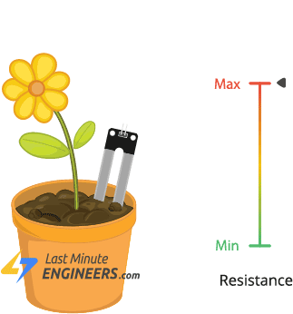
WATER PUMPING FOR DIFFERENT KINDS OF SOILS
The time taken for the system to irrigate potted samples of different soil types having different levels of dryness. The results obtained show that sandy soils require less water than loamy soils and clay soils require the most water for irrigation.

Slide 17
NODE RED
A node-red server is also implemented to make it easier for the end user to monitor the conditions of the plant.
Node-red takes the input from arduino serial port and the values are then displayed with appropriate bar graphs and line charts.

Slide 18
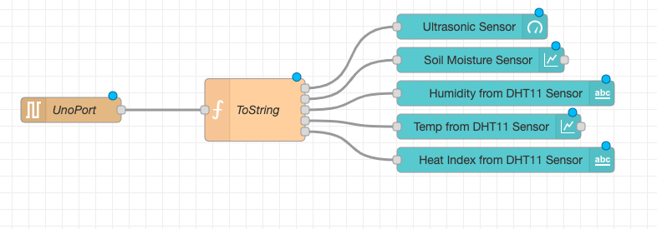
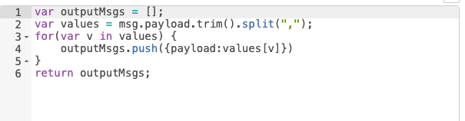
NODE RED

Slide 19
CONCLUSION
This system is beneficial for the people who want to grow the plant but do not have enough time to water the plants, the system is always checking the humidity of soil and supplies water automatically to the plants .The profit of this system is not only to reduce a lot of water usage but also to prevent the plant’s dehydration.

Slide 20
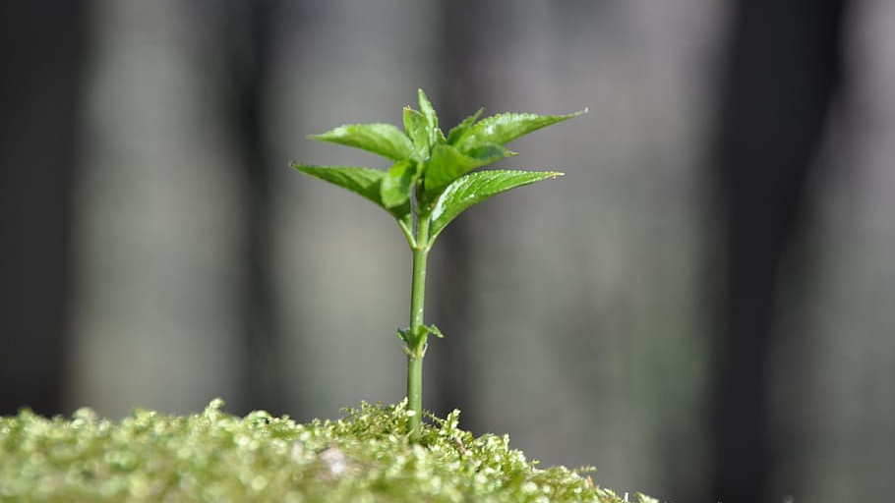
PLANS FOR IMPROVEMENT:
1.It is a temporary set up used in dose only because it needs an electrical outlet in the future we want to use solar power to run it.
2. We can improve the setup by adding alarm feature.
3. This idea can be extended for gardens.

Slide 21
REFERRAL LINKS:
CODE LINK:
https://drive.google.com/drive/folders/1TQoqNiyDYzX0b1BVoH5eiFwUe_Cgu1XO?usp=sharing
CONNECTIONS:
https://www.circuito.io/static/reply/index.html?solutionId=603d1259e909dc00306c885b&solutionPath=storage.circuito.io
WORKING:
https://youtu.be/eztJTjI1OXw

Slide 22


